Slide 1
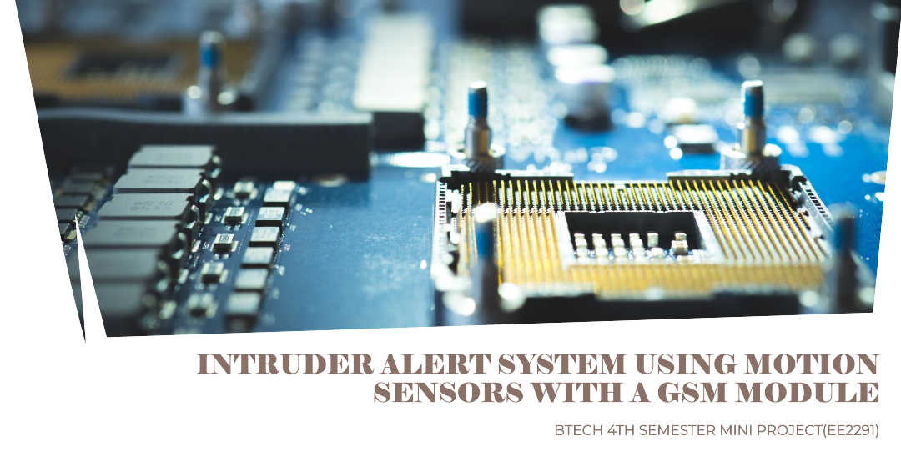

Slide 2
Introduction
In this presentation, we will explore an intruder alert system that utilizes motion sensors and a GSM module. This system offers a cost-effective and reliable solution for residential and commercial security. We will delve into the components, functionality, potential improvements, and overall effectiveness of this system.

Slide 3
PURPOSE
The main purpose of building an Intruder Alert System Using Motion Sensors with a GSM Module is to enhance security and provide remote notification in case of unauthorized entry. Here's a breakdown of our goals:
Intruder Detection: The motion sensors pick up movements within their designated area, indicating a potential intruder's presence.
Alert System: Upon detecting motion, the system triggers an alarm (often a loud buzzer) to deter the intruder and draw attention.
Remote Notification: The GSM module, equipped with a SIM card, allows the system to send SMS alerts to pre-programmed phone numbers. This ensures the property owner or designated contacts are informed even if they're not physically present at the location.

Slide 4
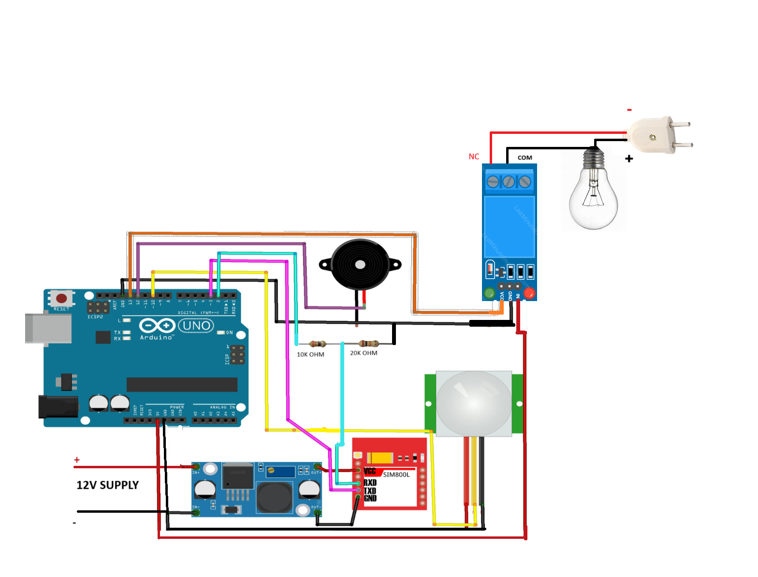
Single Channel Relay Module
Piezo Speaker
Bulb
Arduino Uno
PIR sensor
LM2596S DC-DC Buck Converter
Gsm Sim800l Module

Slide 5
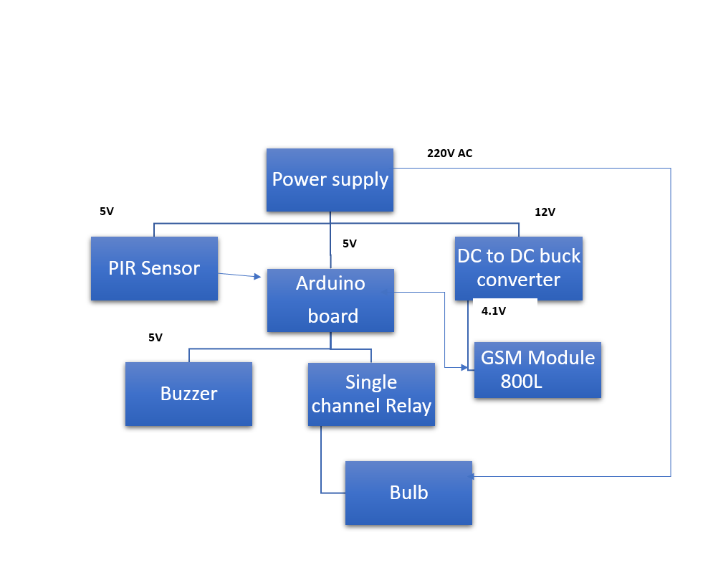
Block Schematic Diagram

Slide 6
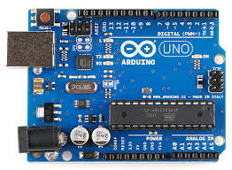
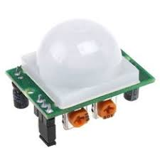
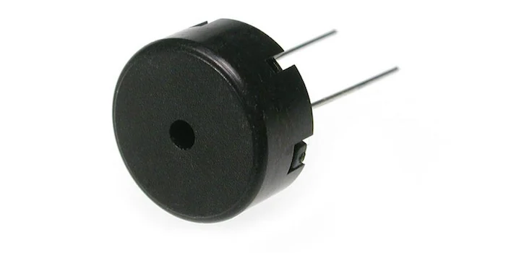
Components
A passive infrared sensor is an electronic sensor that measures infrared light radiating from objects. PIR sensors mostly used in PIR-based motion detectors. Also, it used in security alarms and automatic lighting applications
A piezo speaker is like a tiny buzzer. It uses electricity to vibrate and make sounds, perfect for beeps and simple noises in small devices.
Arduino Uno is a popular single-board microcontroller, a mini computer for electronics projects. It is basically used in communications and in controlling or operating many devices .

Slide 7
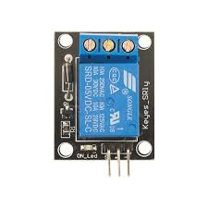
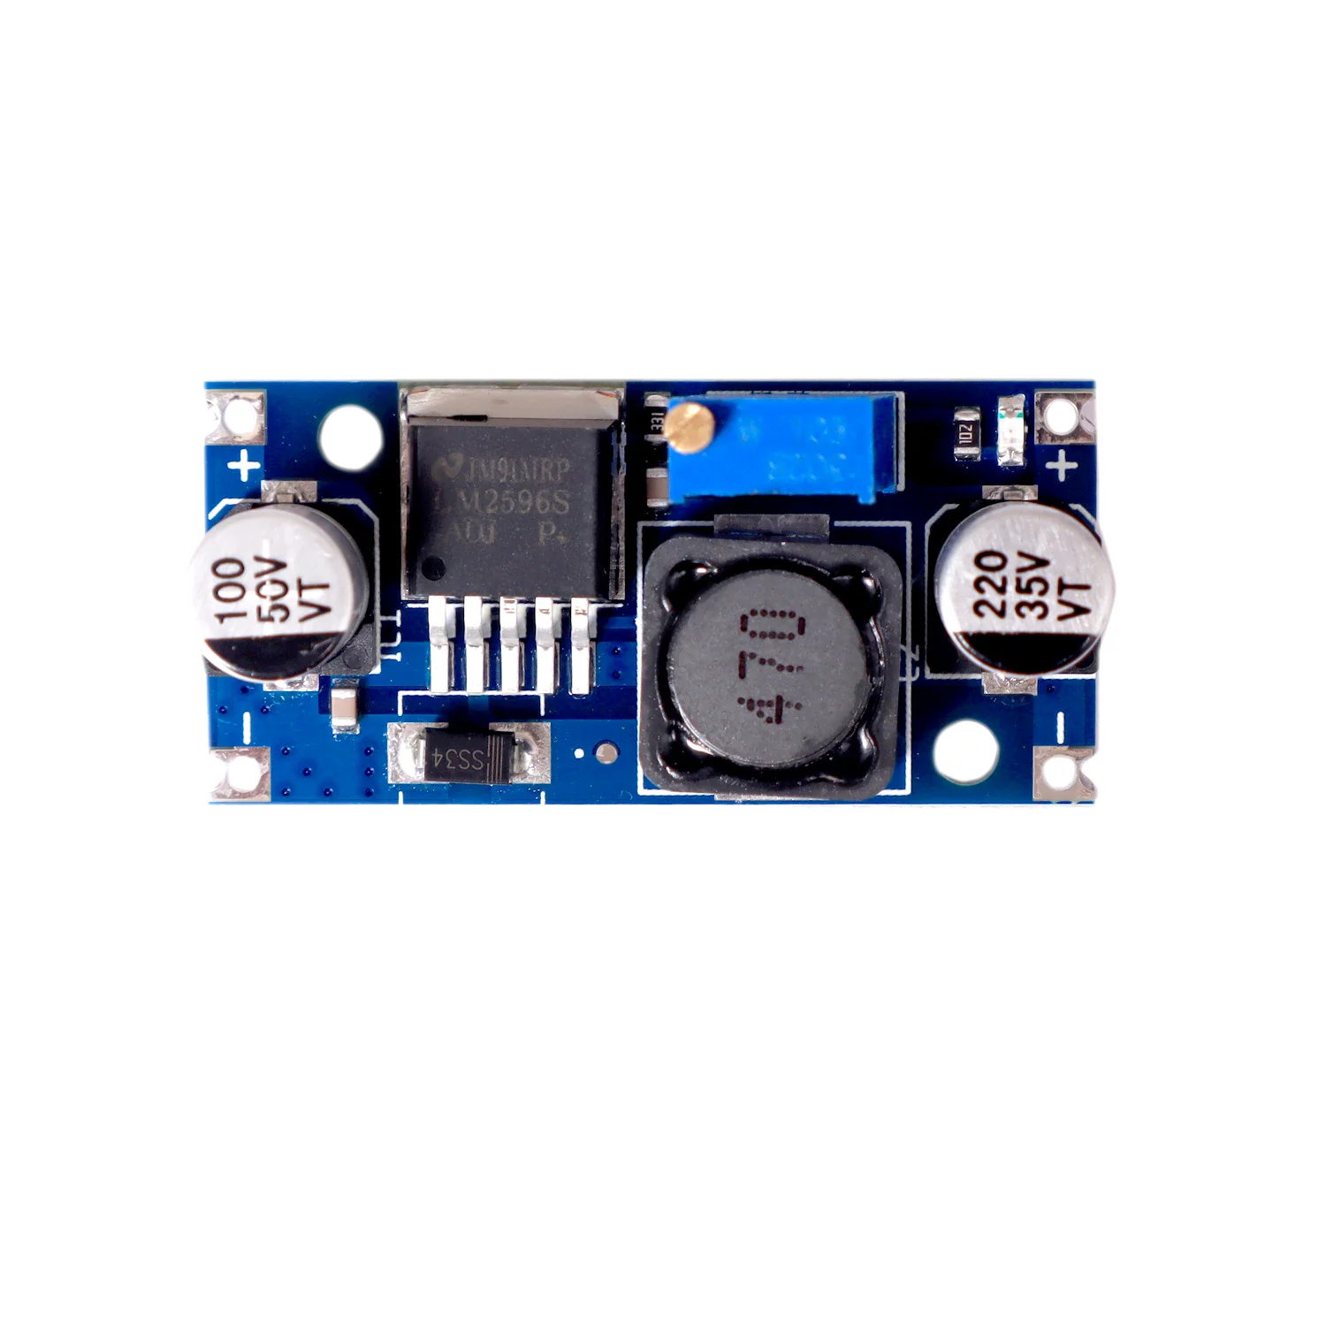
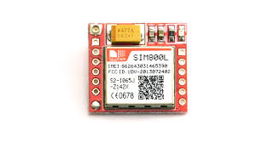
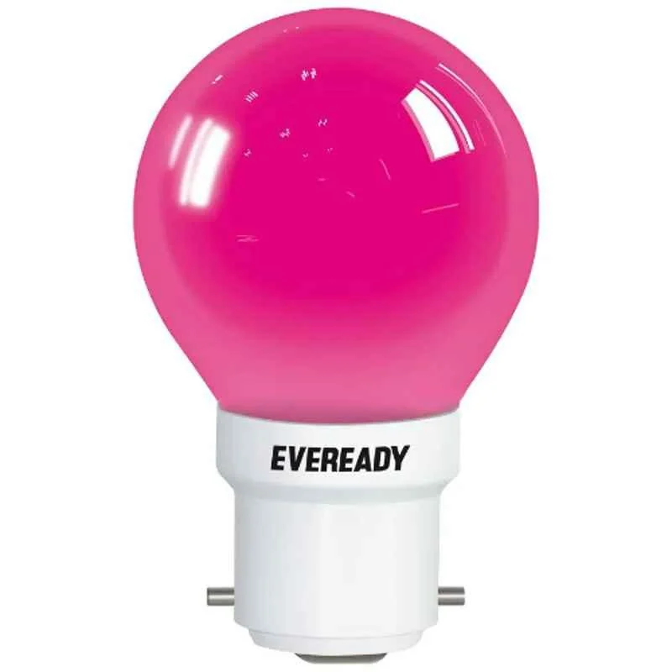
A GSM (Global System for Mobile Communications) module is a compact device that adds cellular network communication capabilities to our project
An electric lamp, more commonly known as a light bulb, is a fundamental lighting technology that efficiently transforms electrical energy into visible light
A relay module is a circuit board that combines a relay with other electronic components to make it easier and safer to use in various applications.
A DC-to-DC buck converter, also called a step-down converter, is a circuit that takes a higher DC voltage and reduces it to a lower DC voltage.

Slide 8
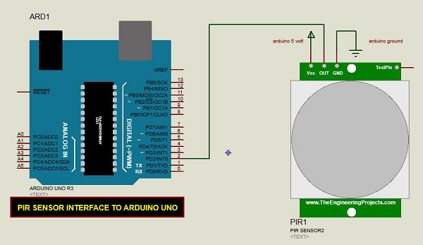
Motion Sensors: Working Principle and Placement
Detection
1
Sensors monitor for infrared changes indicating movement
2
Triggering
Sensors send signals to the control panel to activate alarms
Placement
3
Strategically positioned to cover entry points and high-traffic areas

Slide 9
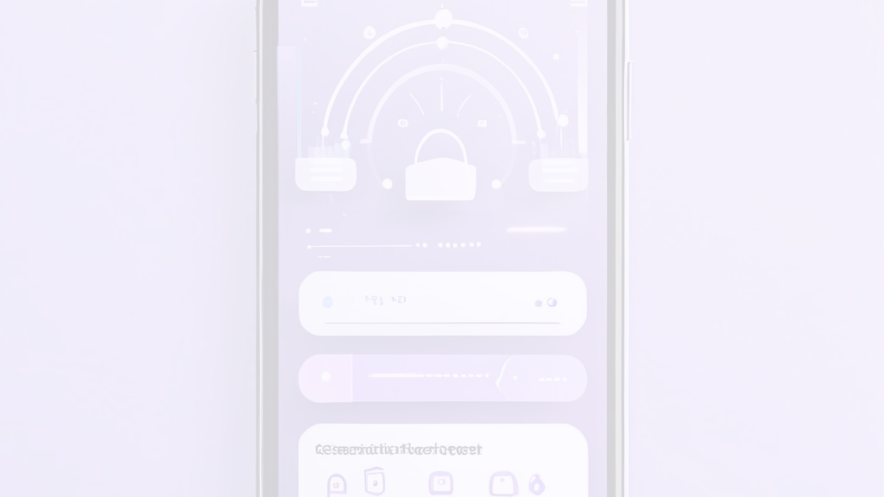
GSM Module: Role and Integration
1
Remote Notification
2
Remote Monitoring
3
Seamless Integration
Alerts homeowners and security personnel via SMS or app
Allows system status checks and control from anywhere
Connects the system to the broader home automation network

Slide 10



Working Methodology
Sensor Activation
Motion triggers sensor to send signal to control panel
Alert Processing
Control panel analyzes input and determines appropriate response
Notification Dispatch
GSM module sends alerts to homeowners and security teams

Slide 11




System Architecture and Connectivity
Sensors
Control Panel
GSM Module
Connectivity
Detect movement and trigger alerts
Coordinates system functions and responses
Enables remote connectivity and notifications
Integrates with mobile phone

Slide 12
Future Enhancements
Expanded Sensor Network
Smartphone App for Enhanced Control
The system's functionality can be enhanced by incorporating additional sensors to provide a more comprehensive security .
A dedicated smartphone app could offer a user-friendly interface for interacting with the system. Users could receive real-time notifications of triggered alarms
Camera Integration for Visual Verification
Cloud Connectivity and Remote Management
Cloud connectivity would enable remote monitoring of the system's status, allowing users to check on their property from anywhere with an internet connection
Improve security with fingerprint or facial recognition

Slide 13
Conclusion
This report has explored the design and implementation of a cost-effective intruder alert system utilizing motion sensors and a GSM module. This system offers a practical solution for residential or commercial security applications, effectively detecting unauthorized entry attempts and triggering real-time notification via phone call alerts. The report has detailed the system's components, functionalities, and limitations, while acknowledging its potential for further development.

Slide 14

THANK YOU

